Slide 1











Trip Hunter

Slide 2

Why to use a travel guide app?
Traveling can be exciting but also challenging when it comes to planning and exploring unfamiliar destinations.
A travel guide app is the perfect solution to streamline your travel experience and make your journeys more enjoyable, efficient, and memorable.

Slide 3
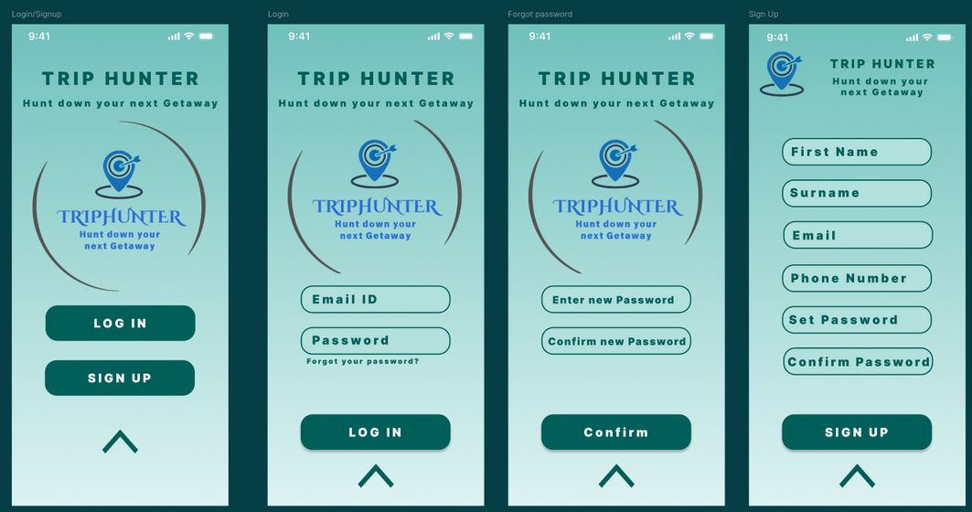
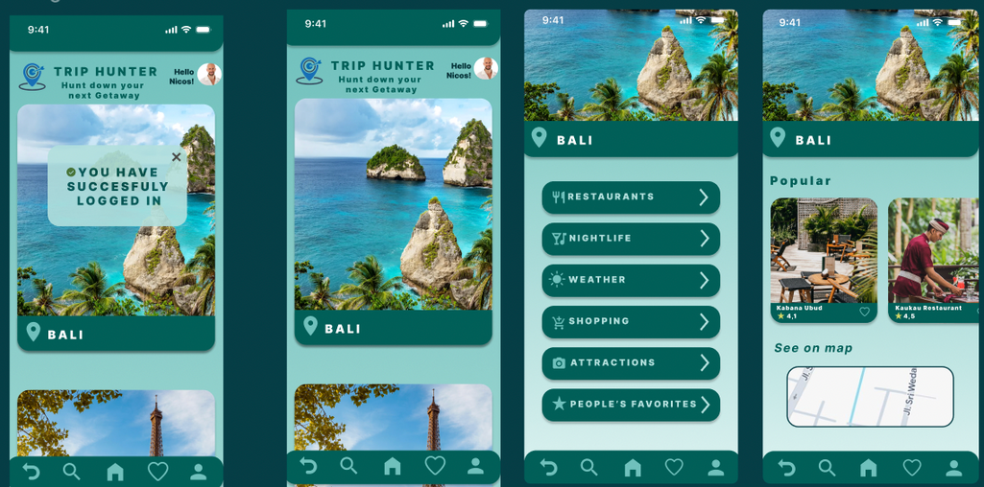

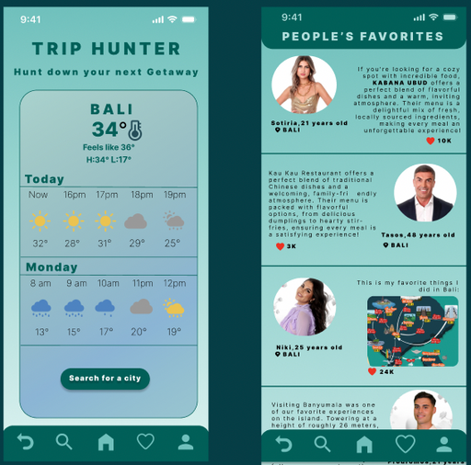
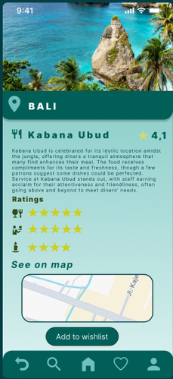
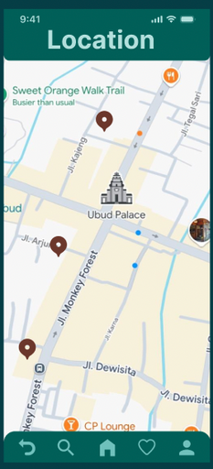
Figma

Slide 4
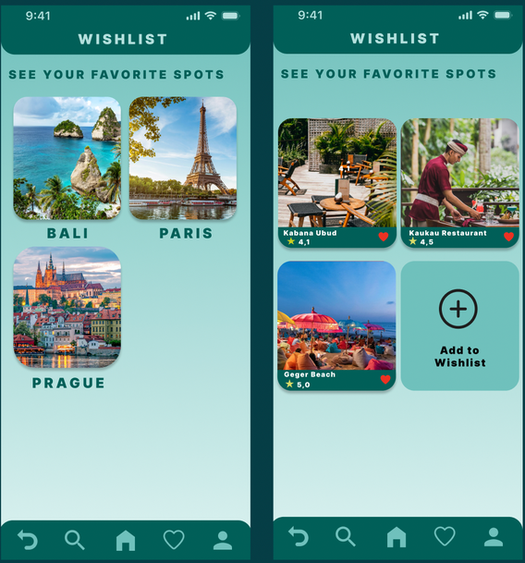
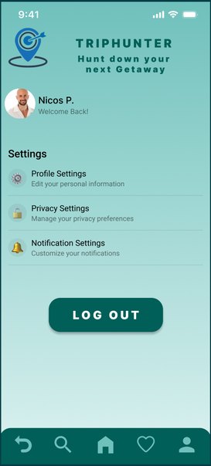
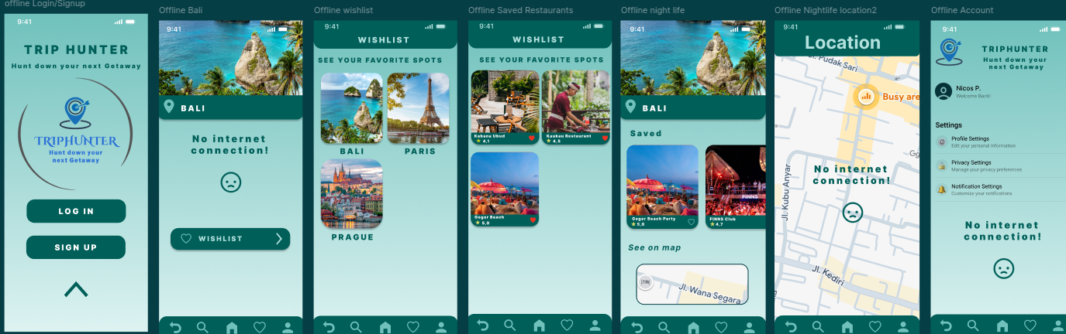
Figma
Navigation Bar
Offline Activity

Slide 5

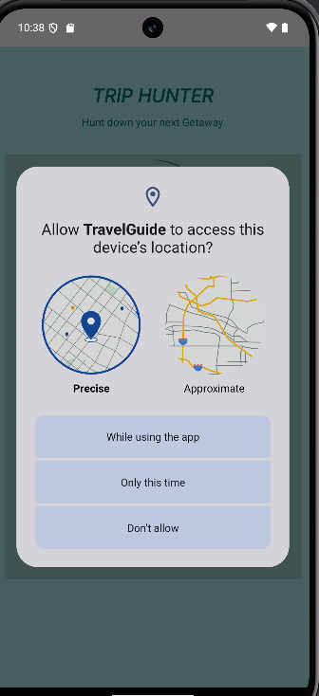
Loading page
This page is a prompt to request the user's location access, which is essential for providing personalized and accurate travel information. The location permission page ensures transparency while giving users control over their data.
The loading page serves as the initial screen users see while the app is starting up

Slide 6
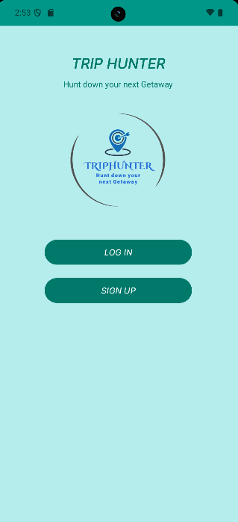
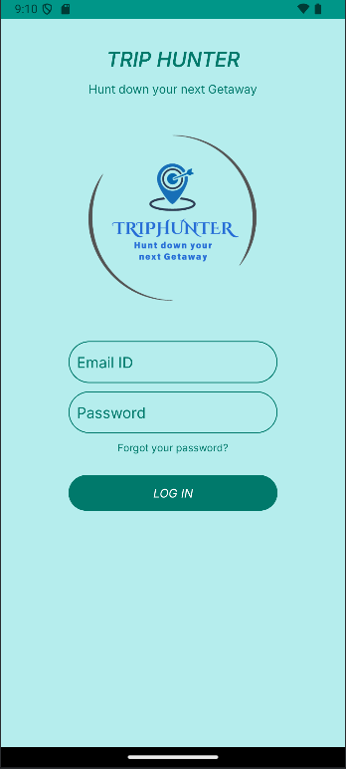
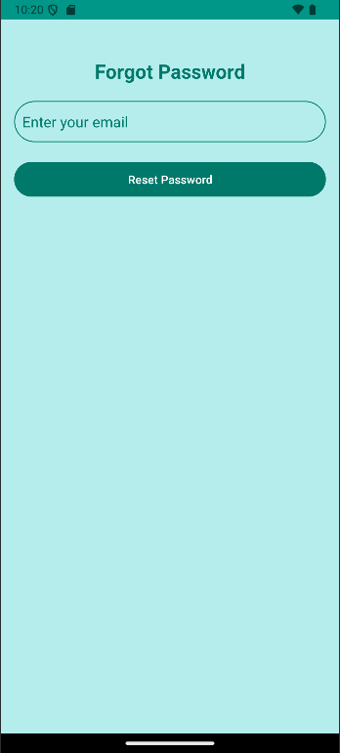
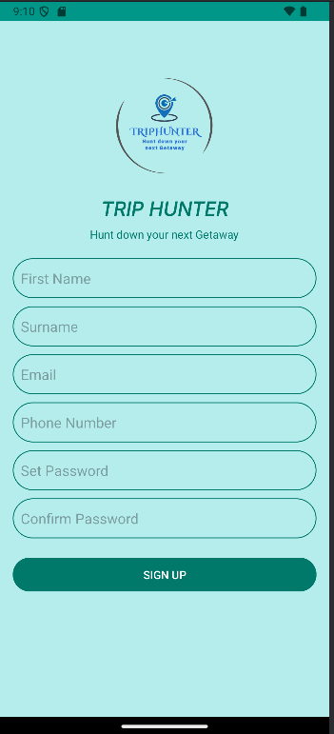
FORGOT PASSWORD Page
Login/Signup Page
Login Page
Signup Page

Slide 7
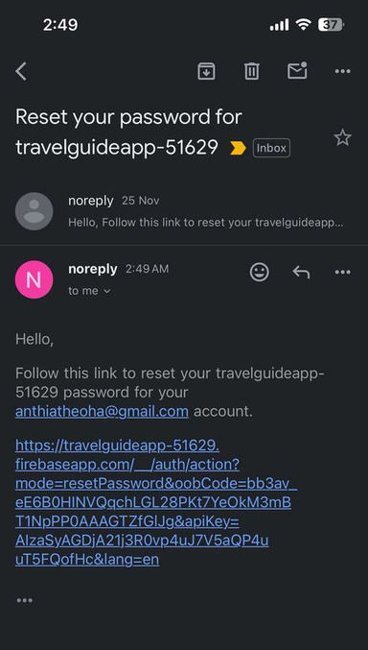
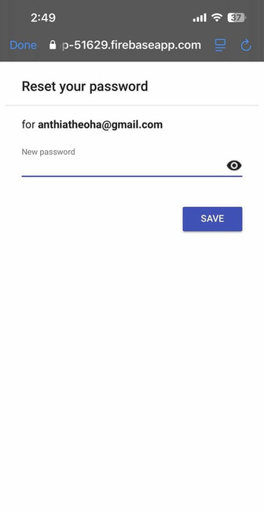
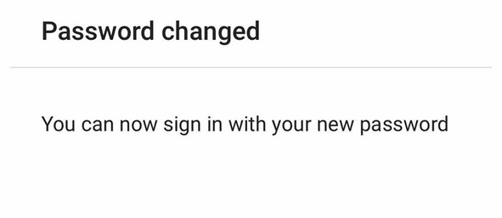


FORGOT PASSWORD Page

Slide 8
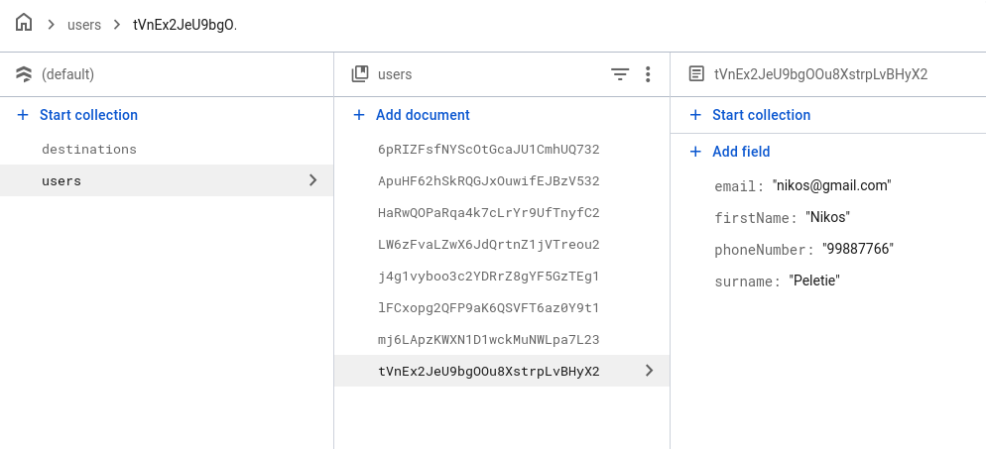
FIREBASE

Slide 9
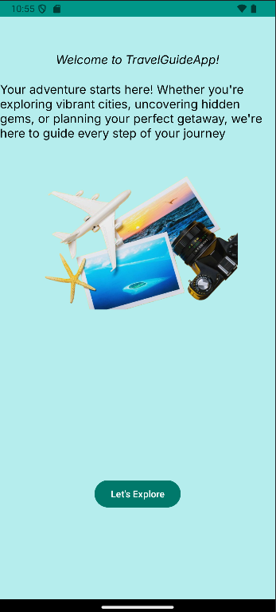
Welcome page
The Welcome Page is the first impression of the Travel Guide App, designed to engage and excite the user about the journey ahead. It sets a warm and inviting tone with a clean and visually appealing layout.
"Let’s Explore" button is prominently placed at the bottom, encouraging users to proceed to the next step

Slide 10
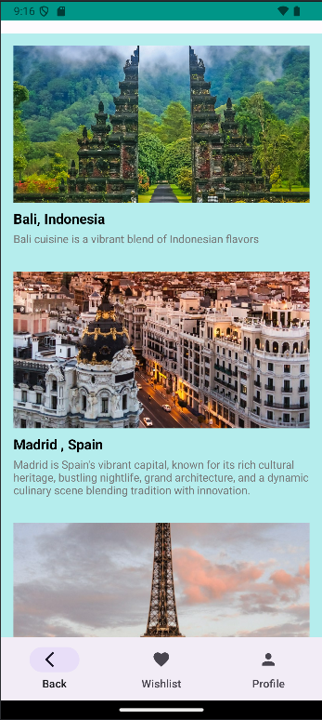
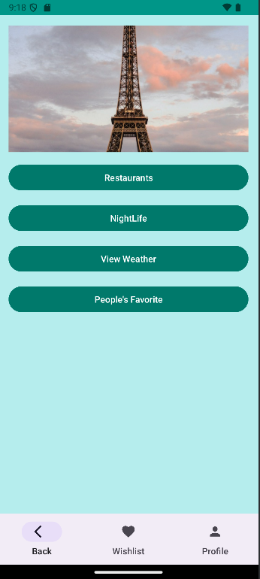
DESTINATIONS
Restaurants: A section to explore popular restaurants and cuisines in the selected destination.
Nightlife: Highlights nightlife spots
View Weather: Provides real-time weather updates to help users plan their outings.
People’s Favorite: Features the most popular spots and recommendations based on user reviews.

Slide 11
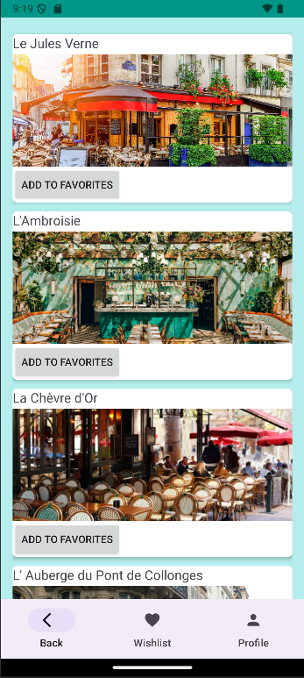
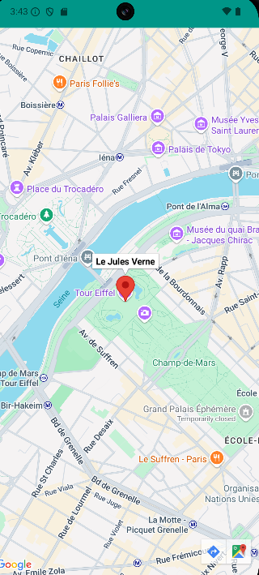
restaurants
Displays a curated list of the user’s favorite restaurants using:
https://console.cloud.google.com/apis/credentials/key/8193a5ff-6546-4172-a525-6cdb2d672476?inv=1&invt=AbihXw&project=travelguideapp-442416

Slide 12
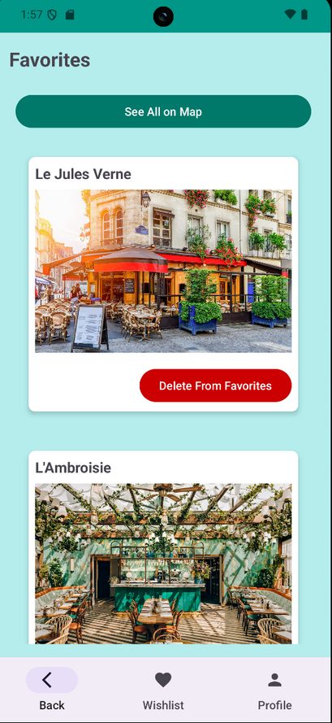
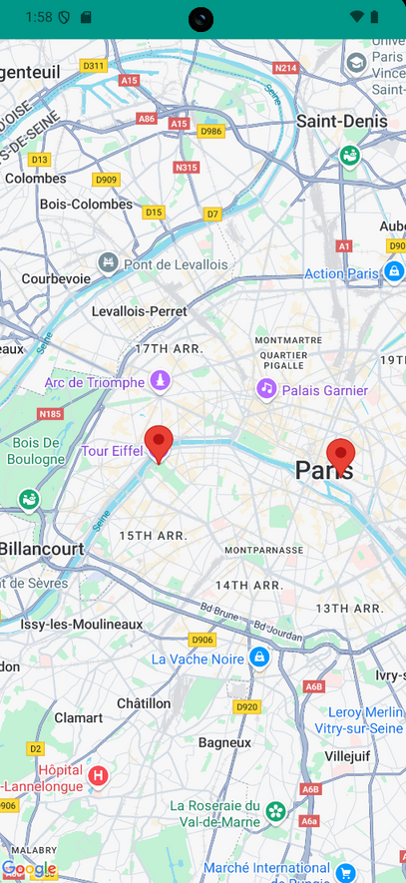
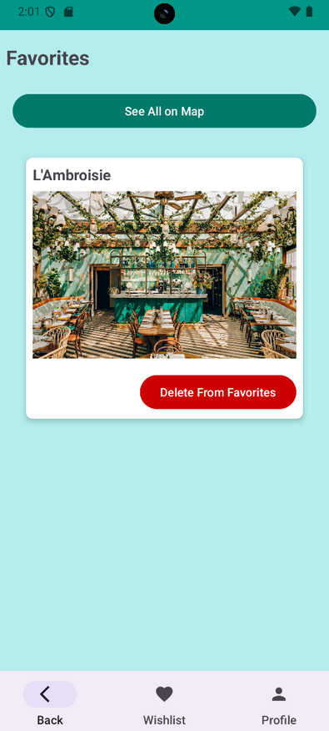
restaurants
This is a favourite list of the user’s favourite restaurants
By clicking “See All on Map” we can see all of our favourite restaurants pinned on the map
A "Delete From Favourites" button below each entry allows users to manage their list efficiently.

Slide 13
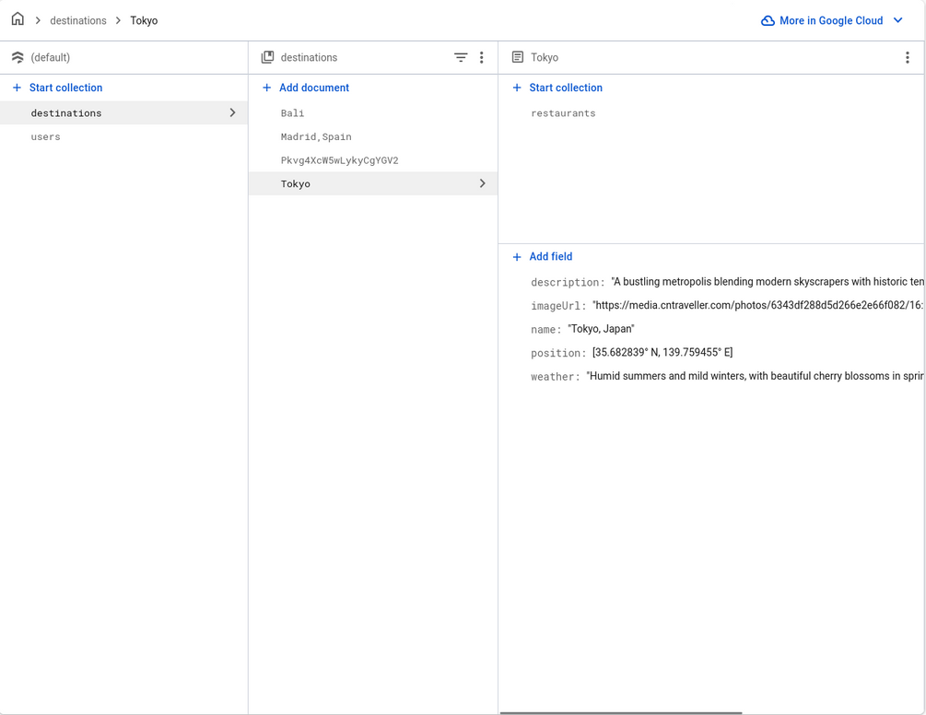
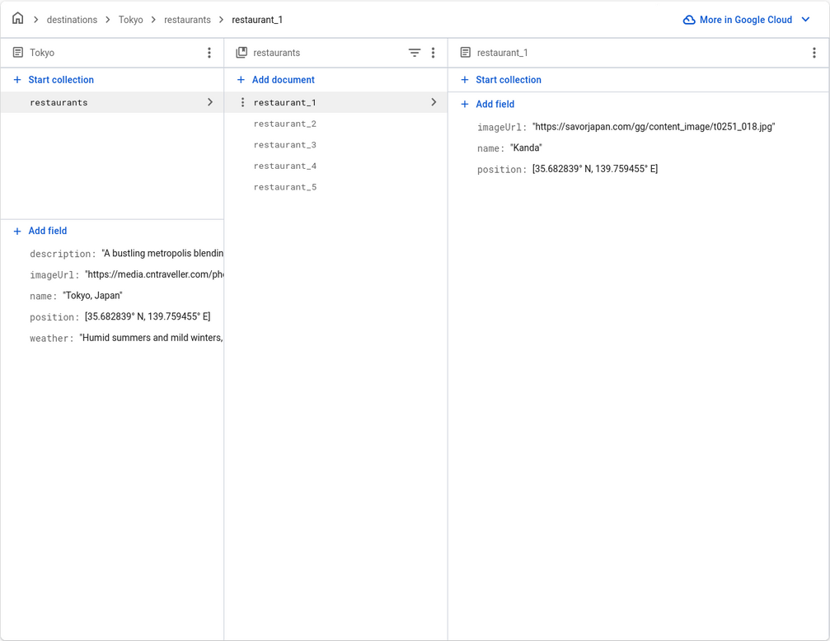
FIREBASE - RESTAURANT

Slide 14
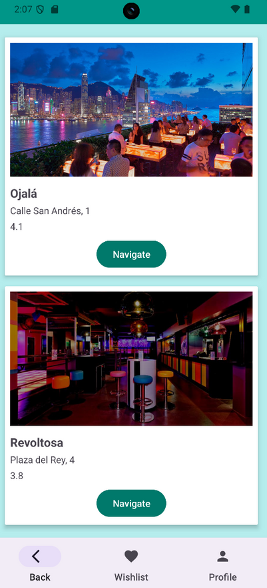
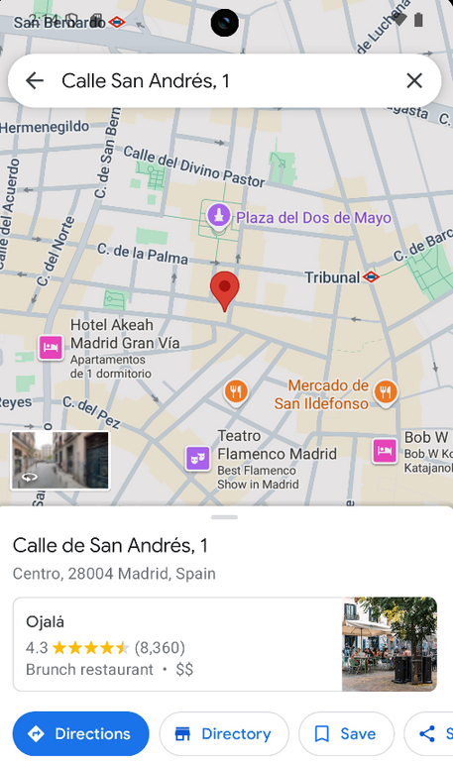
nightlife page
API: https://api.yelp.com/
This page provides users with curated recommendations for nightlife spots, using data from the Yelp API. It integrates real-time information to offer accurate and relevant suggestions, enhancing the user experience.
Navigate to the address using Google Maps

Slide 15
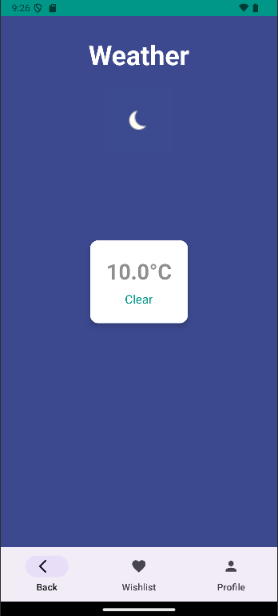
weather page
API: http://api.weatherstack.com/
The Weather Page provides users with live weather updates for their selected destination. The app dynamically displays weather icons and descriptions based on the current weather status.

Slide 16
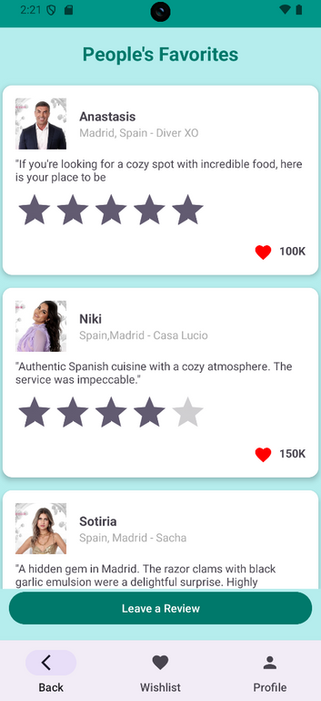
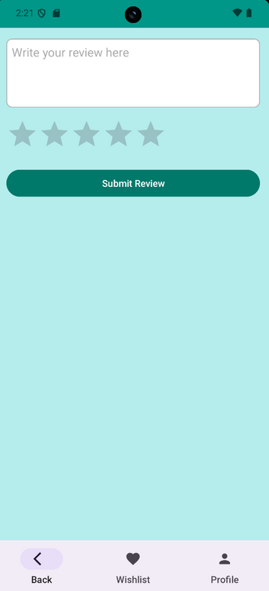
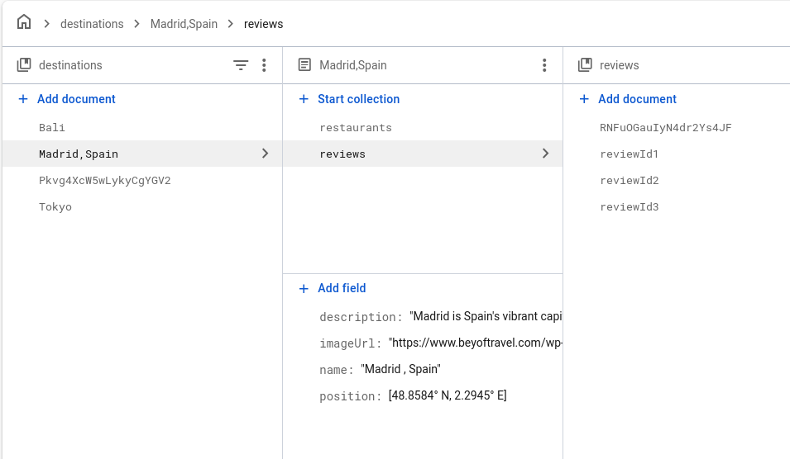
people’s favorite page
The review submission page allows users to share their experiences, helping the community make informed decisions. User reviews are saved and stored securely in Firebase, ensuring they are accessible for all app users.

Slide 17
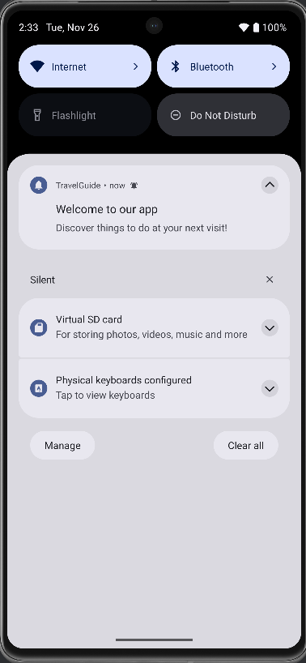
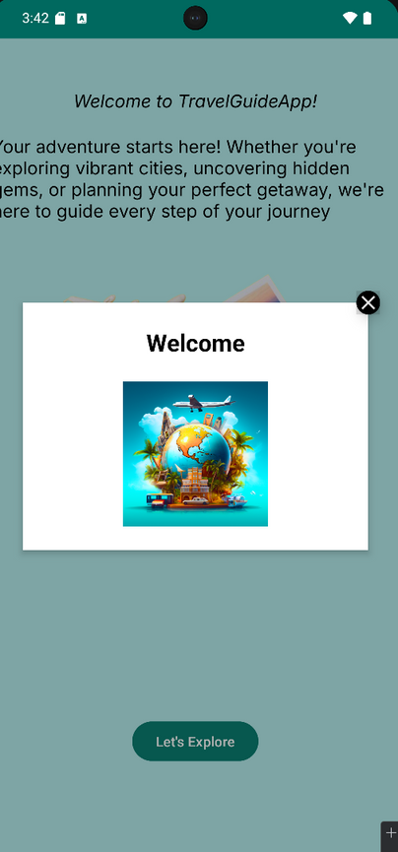
PUSH NOTIFICATION&MESSAGE
Cloud Messaging
In-App Messaging

Slide 18
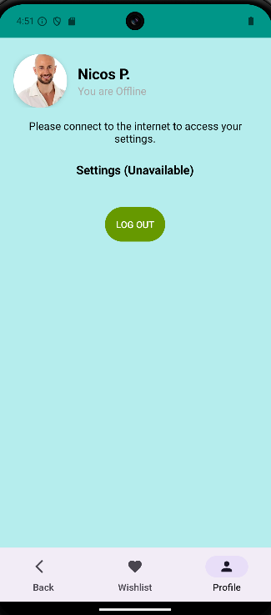
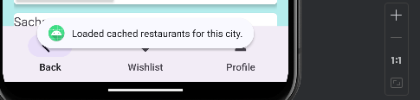
OFFLINE PAGE
Cached data ensures that users can access to the restaurants that previously viewed without internet access.

Slide 19

NAVIGATION BAR
The navigation bar is a core component of the app, designed to provide quick and seamless access to key features
Back Button:
Allows users to easily return to the previous screen, providing flexibility and improving navigation flow.
Wishlist Button:
Provides access to the user’s saved places or wishlist, such as favorite locations they want to explore in the future.
Profile Button:
Directs users to their profile and settings page, enabling quick access to account management options.

Slide 20
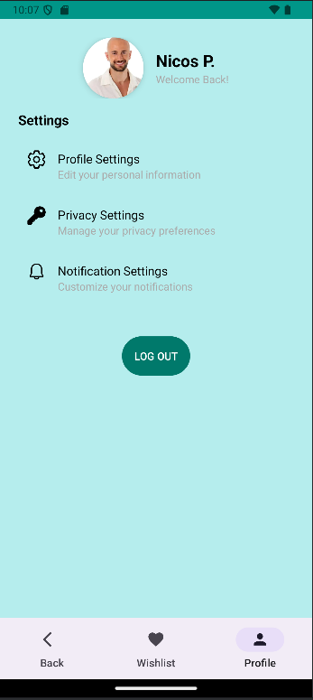
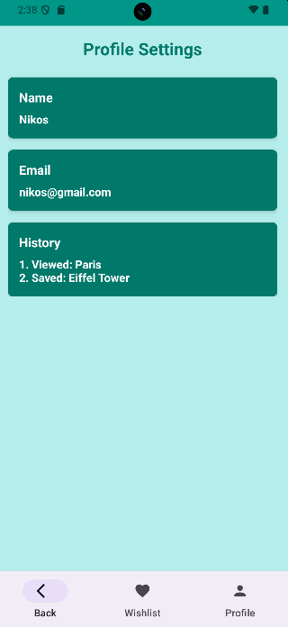
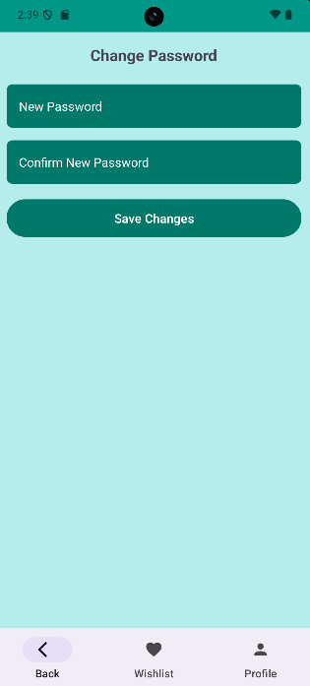
profile page
Displays the user’s profile picture and name with a welcoming message
A "Log Out" button at the bottom ensures users can easily exit their account when needed.
The Profile Settings page displays the user’s personal account details and browsing history.
The Change Password page allows users to update their account credentials securely.

Slide 21
Thank you for exploring
Chrysanthi Theocharide
Eleni Loizou
Stylianos Panayiotou
https://github.com/lne2003/TravelGuideApp.git

